Slide 1






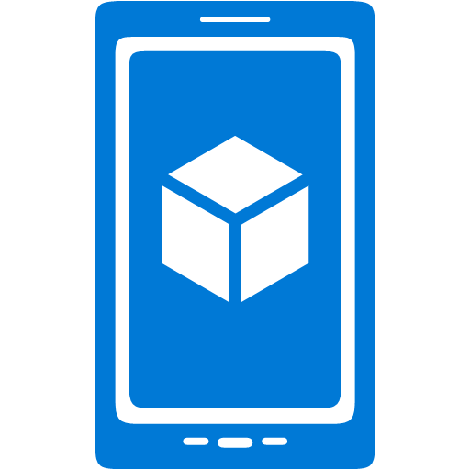


























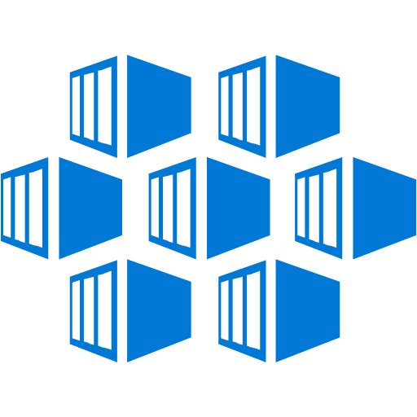
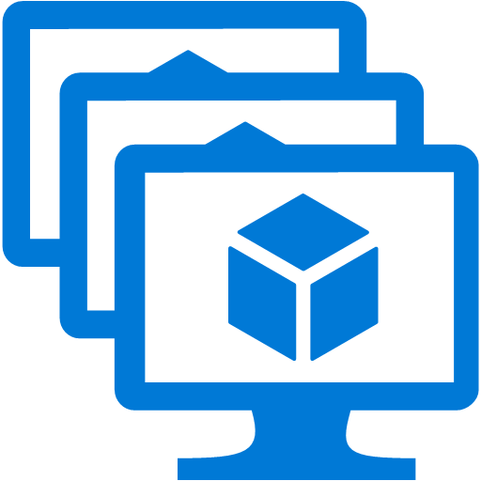


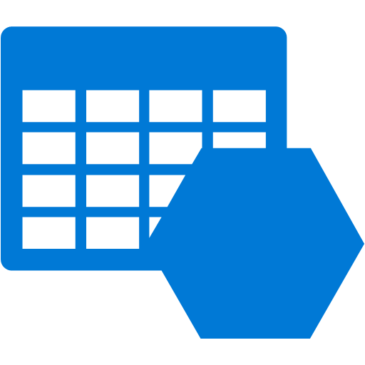






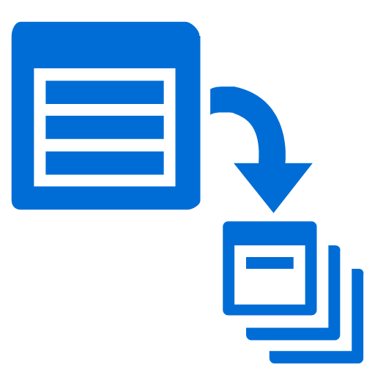








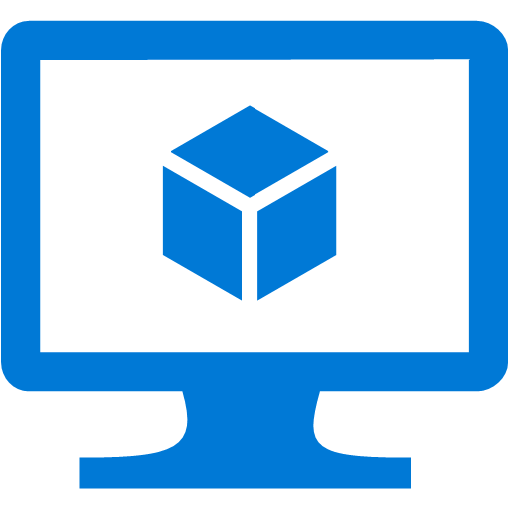








Platform Services
Security & Management
Hybrid
Cloud
Media & CDN
Application Platform
Data
Security Center
SQL
Database
Azure Synapse Analytics
Azure AD Connect Health
Media Services
Media Analytics
Content Delivery
Network
Web
Apps
Mobile
Apps
Cosmos DB
Azure portal
AD Privileged
Identity
Management
Integration
SQL Server
Stretch Database
Azure
Cache for Redis
Table Storage
Azure
Search
Azure Active
Directory
API
Apps
Cloud
Services
Azure AD
B2C
API
Management
Domain Services
Service
Fabric
Notification
Hubs
Intelligence
Service Bus
Multi-Factor
Authentication
Azure Logic
Apps
Functions
Cognitive Services
Bot Services
Azure ML Studio
Backup
Automation
Developer Services
Analytics & IoT
Azure Monitor
Compute Services
Key Vault
HDInsight
Machine
Learning
Stream Analytics
Container
Service
VM
Scale Sets
Visual Studio
Mobile
Engagement
Import/Export
Azure
Marketplace
Data
Catalog
Data Lake
Analytics Service
Data Lake Storage
Azure DevOps
Xamarin
Azure Site
Recovery
VM Image Gallery
Azure Batch
Dev/Test Lab
Data
Factory
Power BI
Embedded
Application
Insights
Visual Studio App Center
IoT Hub
Event
Hubs
…
StorSimple
{ }
REST API and CLI
Infrastructure Services
Compute
Storage
Networking
Virtual Machines
Containers and Azure Kubernetes
Blob
Queues
Files
Disks
Virtual Network
Load Balancer
DNS
Express
Route
Traffic Manager
VPN Gateway
App
Gateway
Datacenter Infrastructure
Notes:
Why this Slide:
It shows we have a very broad platform. It about BOTH IaaS and PaaS, that these work together. It shows that we continue to lead in world class IT capabilities and that there’s really nothing missing.
Key Points:
We have already seen how the Azure Platform is IaaS + Pass – but I want you to understand that this is a huge number of capabilities – IT building blocks if you will.
Every one of these blocks you provision anytime, self-service anywhere in the world 24x7. You pay for what you use, you can get more or less anytime and you can fully automate everything…
DON’T spent too much time on this slide – you are going to DEMO (aren’t you!!!)… DON’T go through each block…
Transition to NEXT Slide: Make the build go backwards to show JUST IaaS and then you will go to the demo to show it.

